Slide 1


Course: Object Oriented Programming
Classes and Objects
The blueprints and instances that build reliable software
Evis Plaku

Slide 2


OOP in a nutshell
Model real entities with code that’s easier to grow
Code mirrors real things: objects with data and actions acting together
Classes define shared design; objects are concrete, with their own state
This mapping keeps programs understandable, extendable, and safer over time

Slide 3

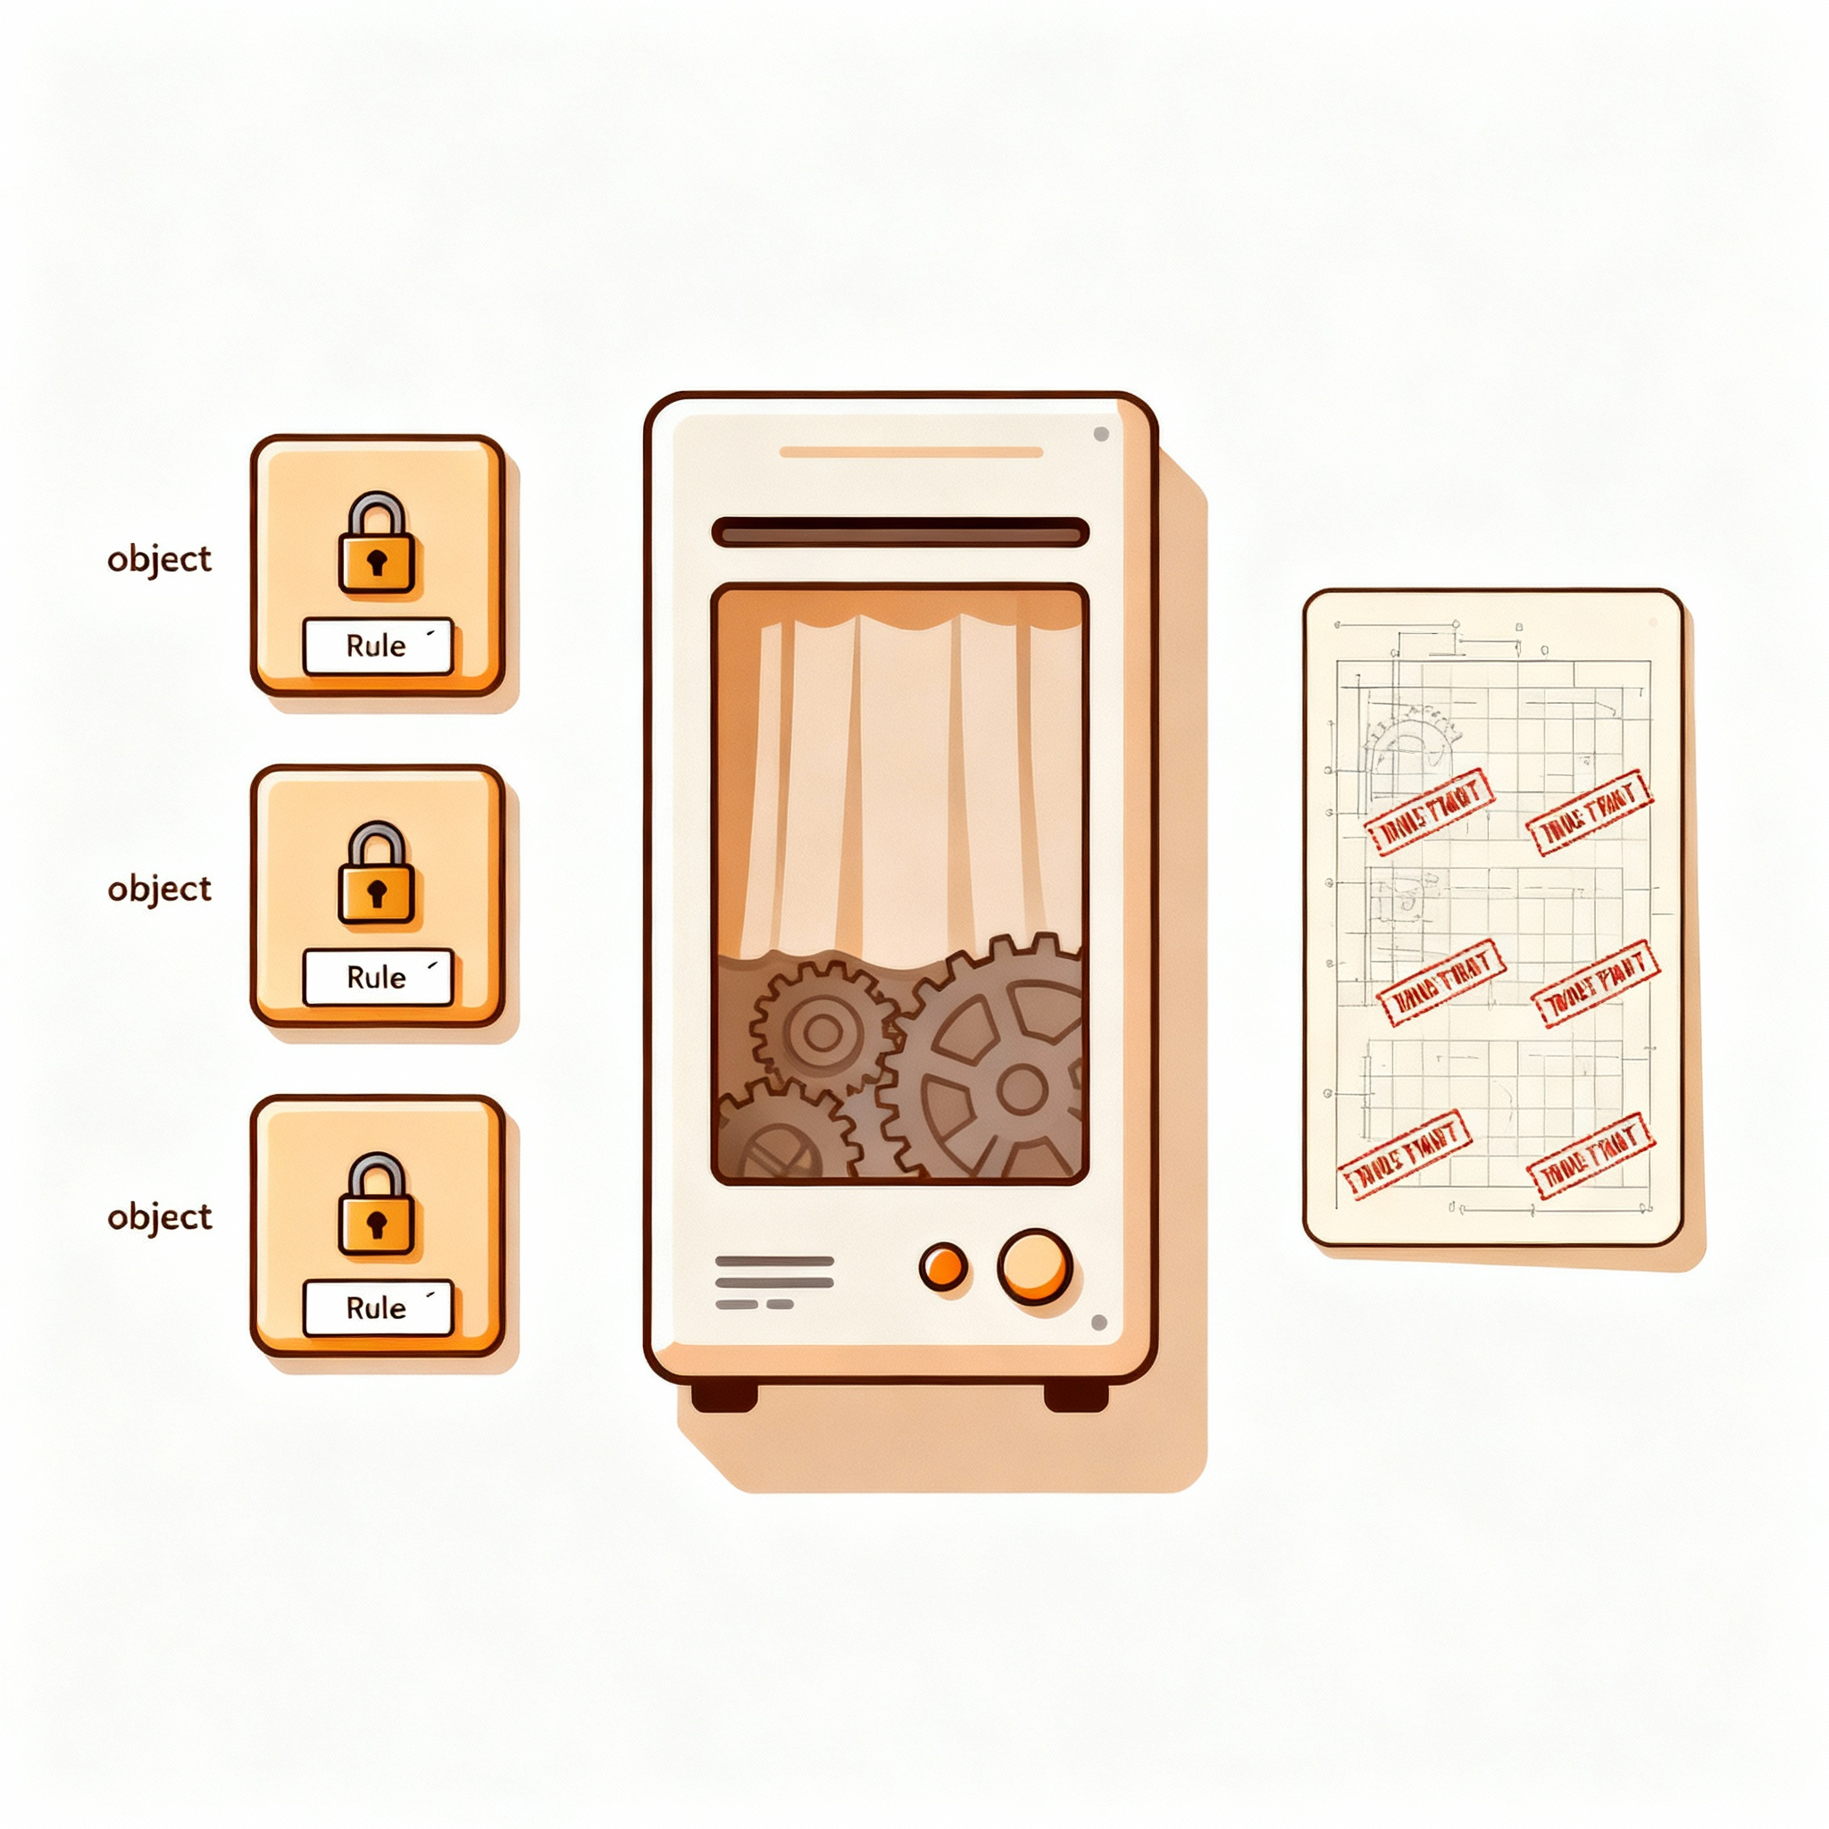
Why classes and objects
Clear structure, safer changes, reusable behaviors
Group data with behavior, so each object guards its own rules
Hide internals; expose small methods, enabling safe, focused changes later
Reuse class designs to create many objects, reducing duplication across code
Internal mechanisms
Class as a blueprint
Objects

Slide 4

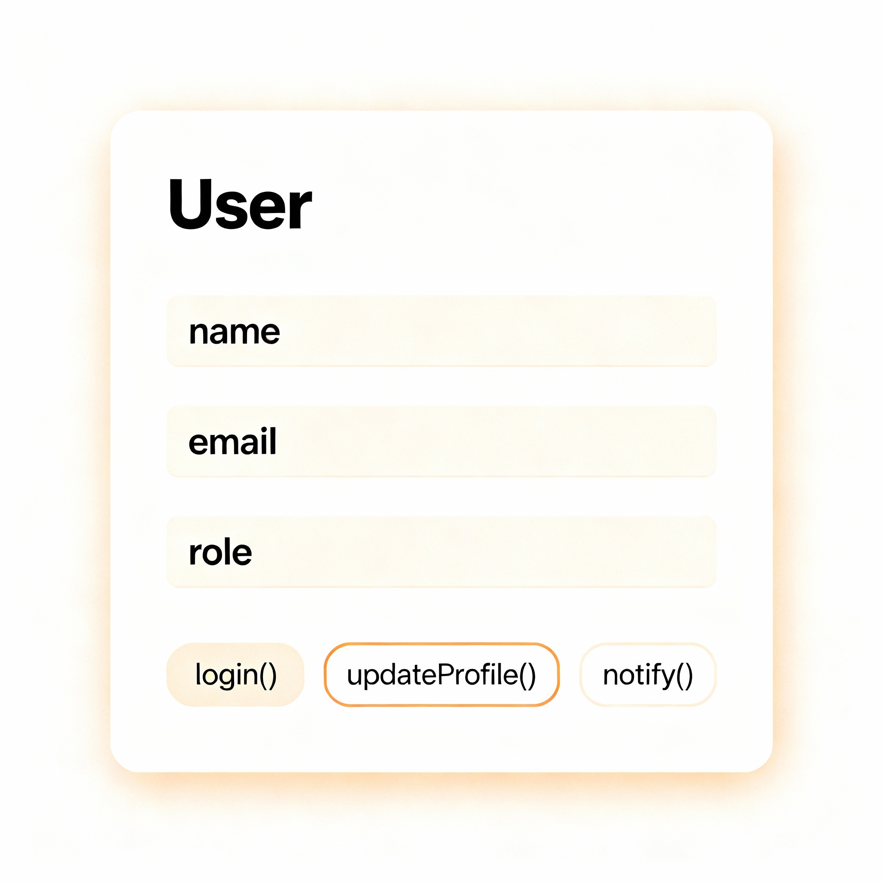
The concept of a class
A class defines state and behavior no concrete data yet
A class is a user-defined type describing fields and methods precisely
It specifies valid data and actions; it does not hold any actual values

Slide 5

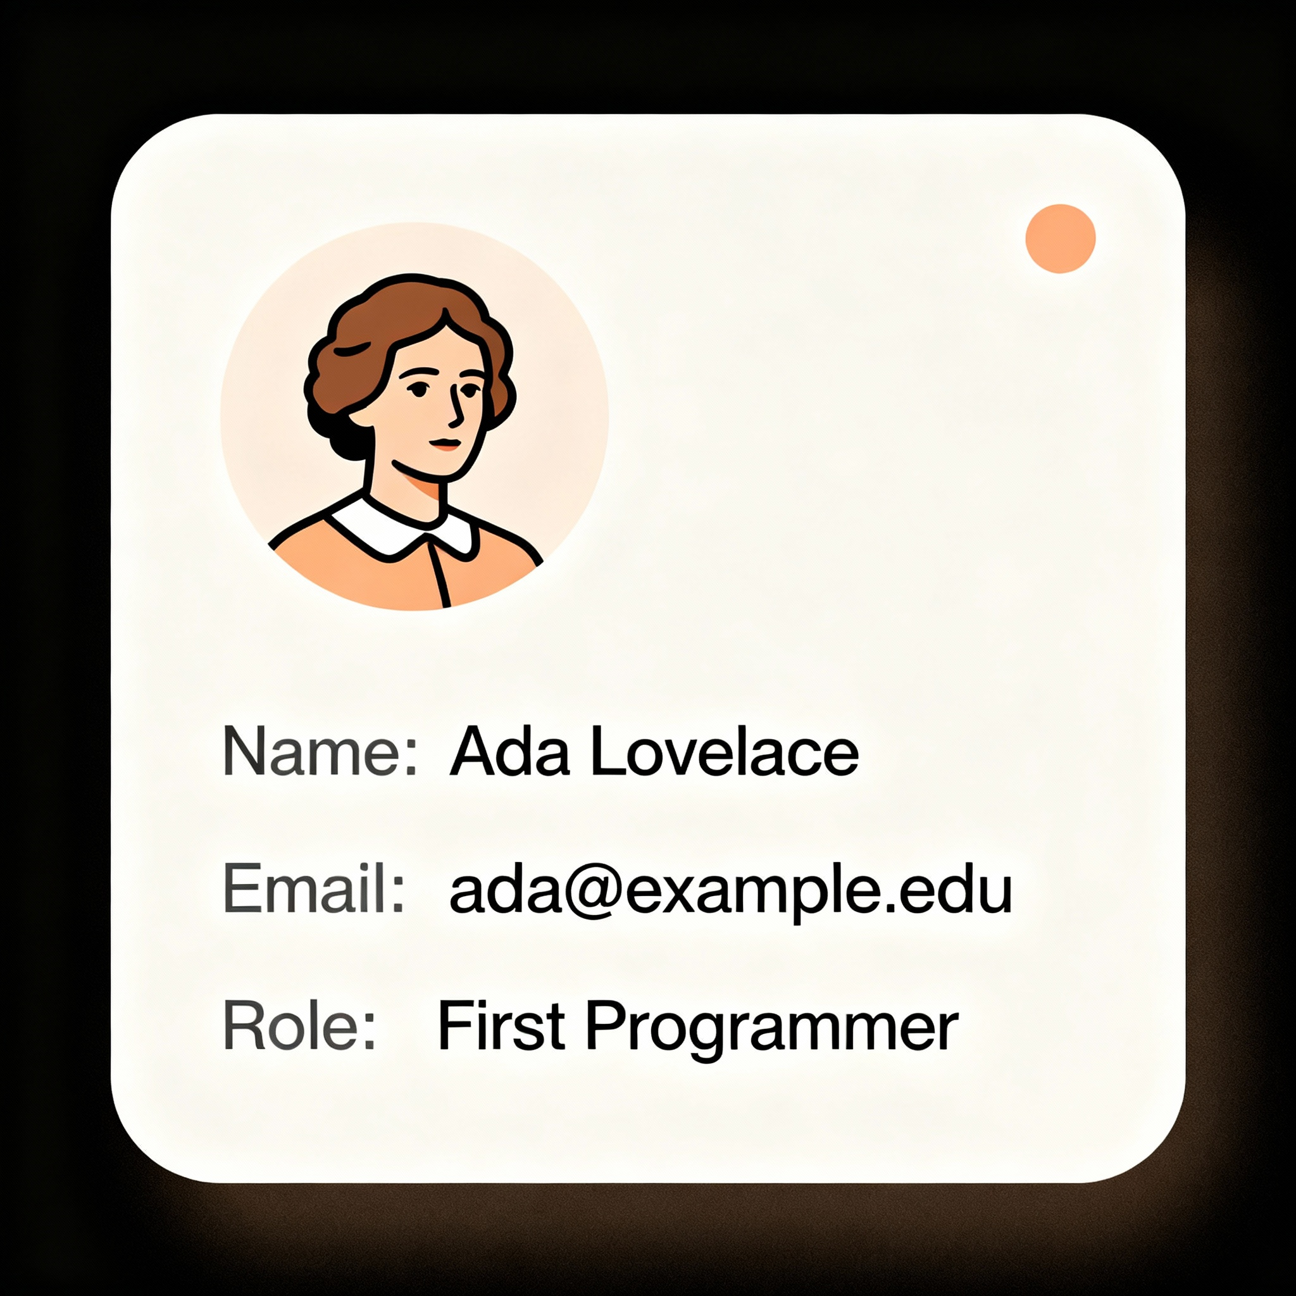
The concept of an object
A live entity with actual data and identity
An object is a created entity with its own data and behavior
It holds current values in fields and runs methods that act on them

Slide 6

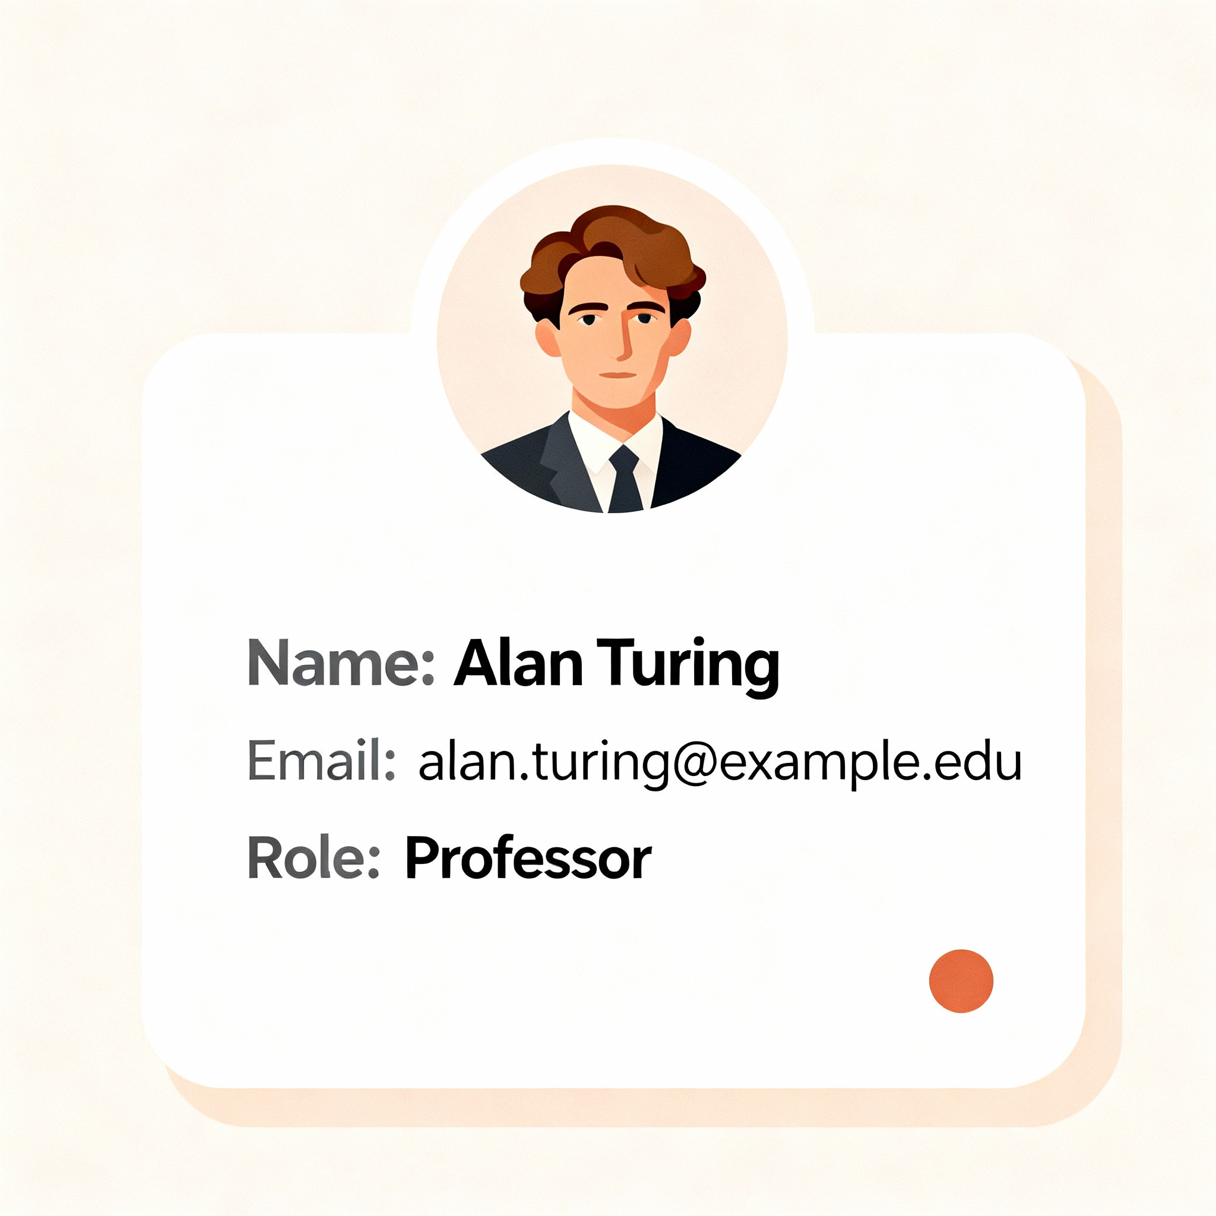
Many objects, one class
Instances share a design but hold different state
Fields are named variables inside a class that hold an object’s state
Methods are functions inside a class that operate on that object’s state
Clear rule: fields store data; methods expose safe, well-defined behavior

Slide 7

Class Essentials
Class
Attributes
Methods

Slide 8

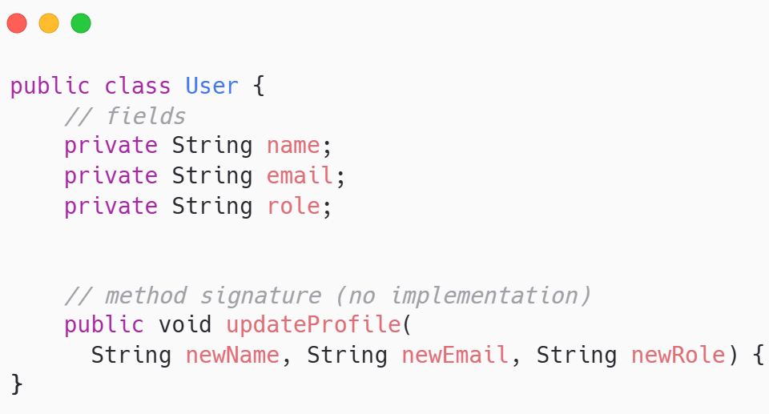
Fields and methods
State in fields; actions in methods
One class defines the shared fields and methods all instances will have
Each object stores its own values for those fields at a given time
Multiple instances follow one class design, each with unique state

Slide 9

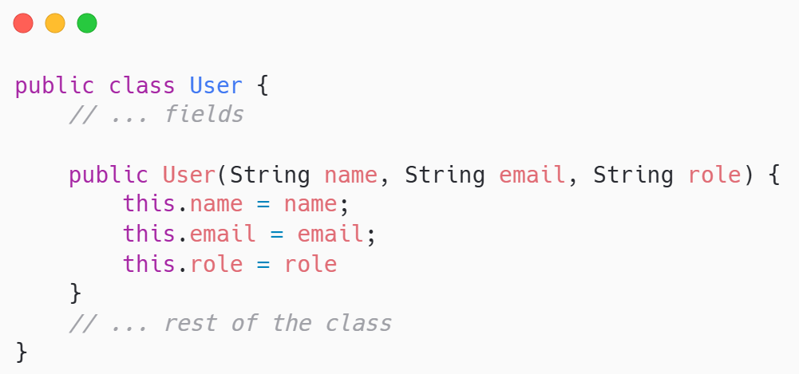
constructors
Set valid initial state when creating objects
Special method run at creation that prepares fields to valid values
Often takes parameters to require needed data and enforce class rules
Sets things up so the object starts out valid

Slide 10

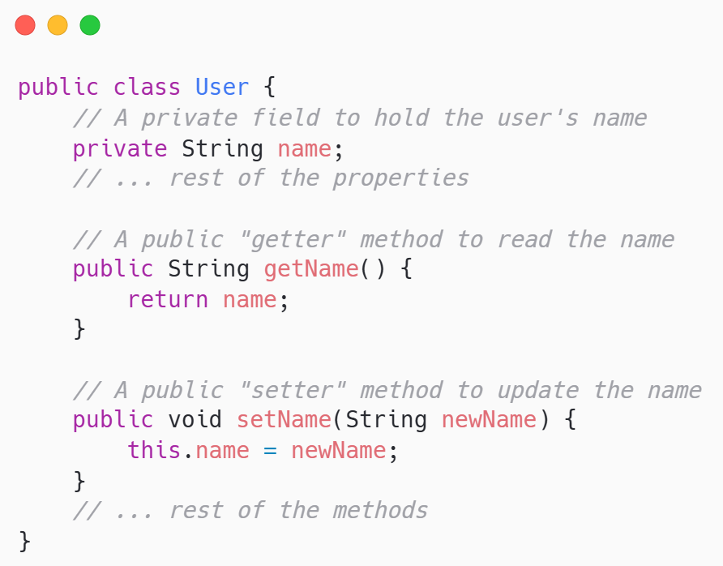
Encapsulation: get and set methods
Control access; guard invariants
Keep fields private; expose small public methods to read or change values
Validate in setters; never allow invalid data to enter the object
Simple rule: get reads safely; set updates safely with checks

Slide 11

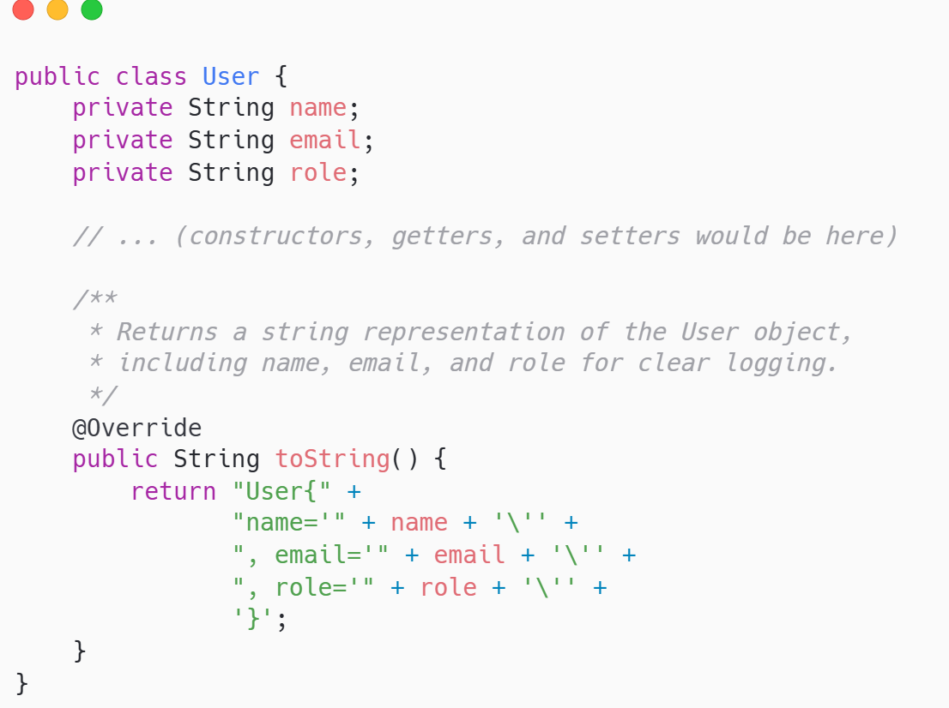
To string method
Human-readable summaries for logs and debugging
Returns a clear text view of an object’s current important fields
Override it to show meaningful details instead of class name and hash
Simple rule: make prints and logs useful at a glance

Slide 12

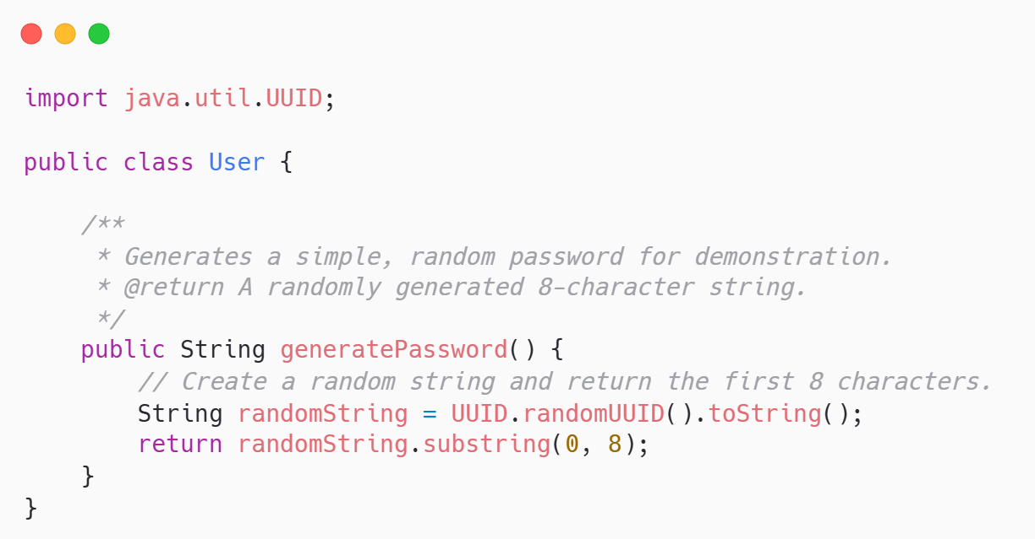
Class methods
Express domain behaviors clearly and simply
Put real actions in methods: what the object should do in the domain
Name methods by intent: transfer, closeAccount, generatePassword, calculateInterest
Keep methods small, with clear rules and checks for valid outcomes

Slide 13
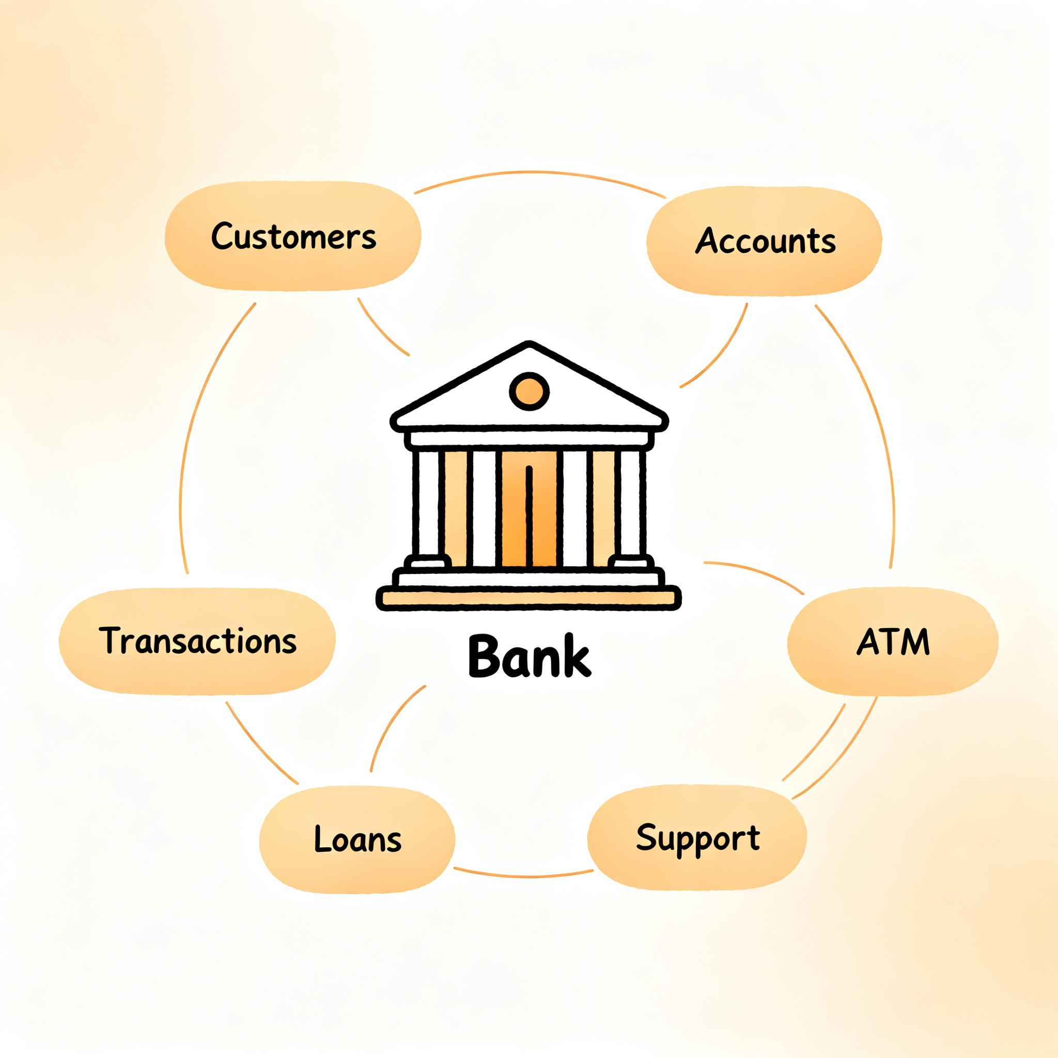
Bank System Example

Slide 14

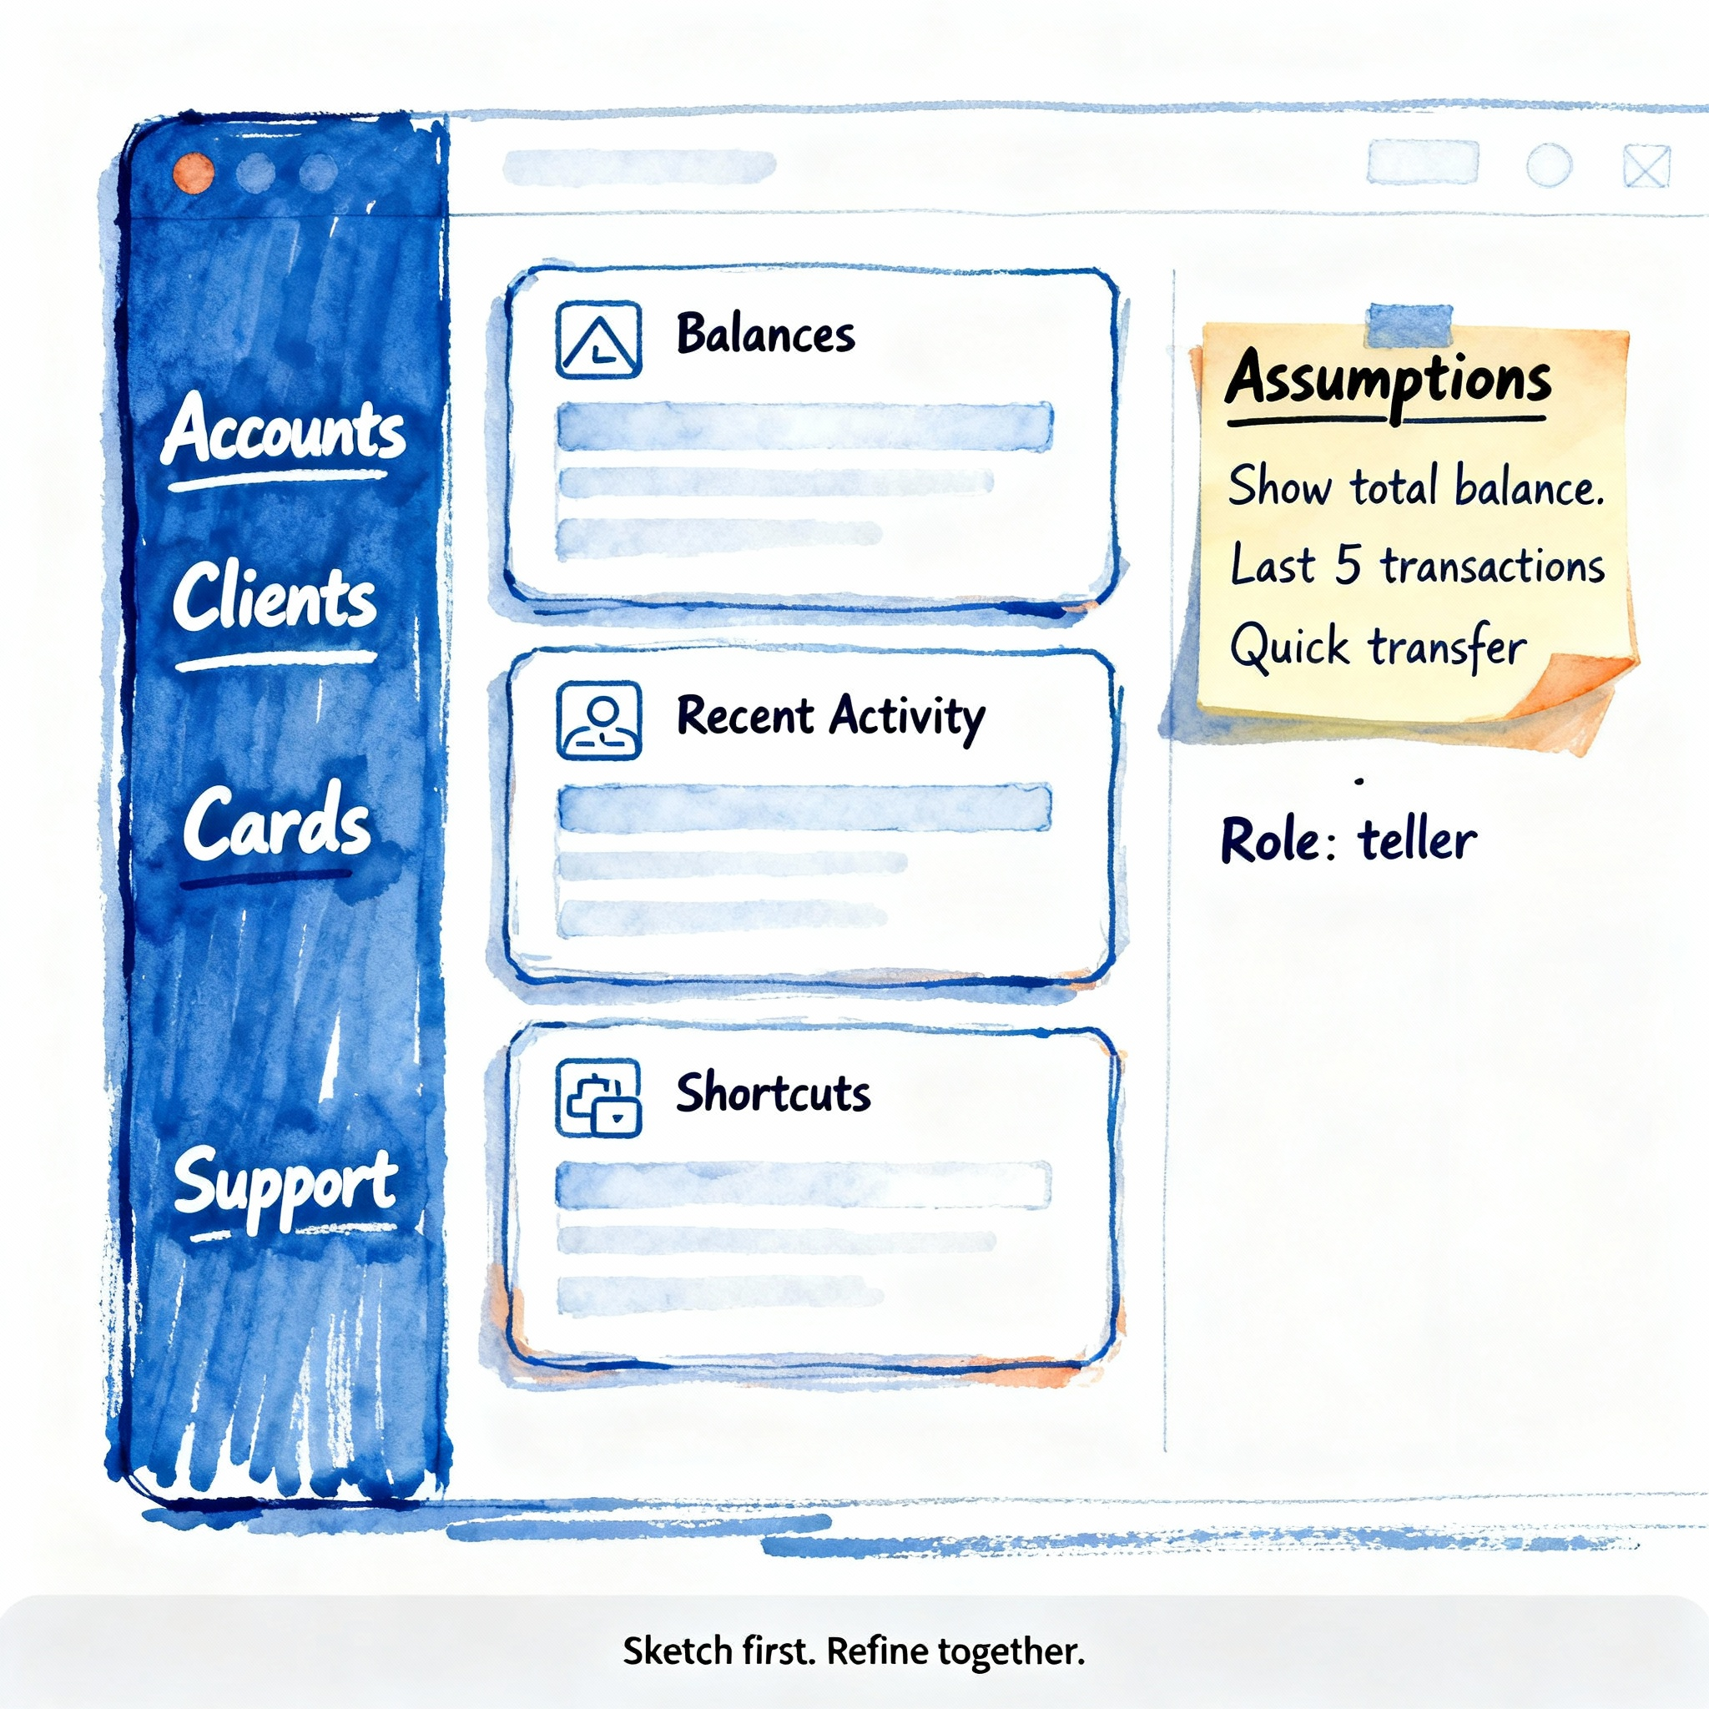
Our Running Example: The Bank Management System
A system to manage customers, their accounts, and core financial activities
Purpose: model key banking functions, focusing on safe customer and financial management
Key entities: Customers (the people), Accounts (the money holders), and Transactions (the actions)
Key operations: open/close accounts, deposit/withdraw funds, check balances, and transfer money

Slide 15



Domain sketch: the bank
Customers hold accounts; Accounts hold money
Customer
Account
Transaction
The central entity, representing the owner with a unique ID and contact info
All financial activity begins with a customer
A container for money, identified by an account number and owned by a customer
It holds the balance and has rules for deposits and withdrawals
An immutable record of a single financial event, like a deposit or transfer
It provides the essential audit trail for every account

Slide 16

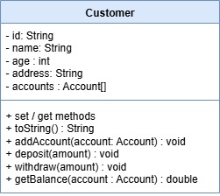
Customer entity
A customer is a key entity in the bank management system
Identified by a unique ID, it holds essential personal data like name and email
Maintains a list of associated Account objects, modeling the ownership relationship
Acts as the central entity for a user, initiating actions like opening new accounts

Slide 17
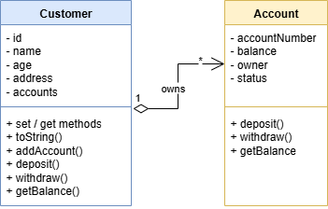
Account entity
An account is a key entity in the bank management system
Uniquely identified by an accountNumber, it's a specific, addressable financial record
Tracks the current balance and maintains a clear link back to its owner
Its status (e.g., OPEN, FROZEN) dictates which operations are currently permitted

Slide 18

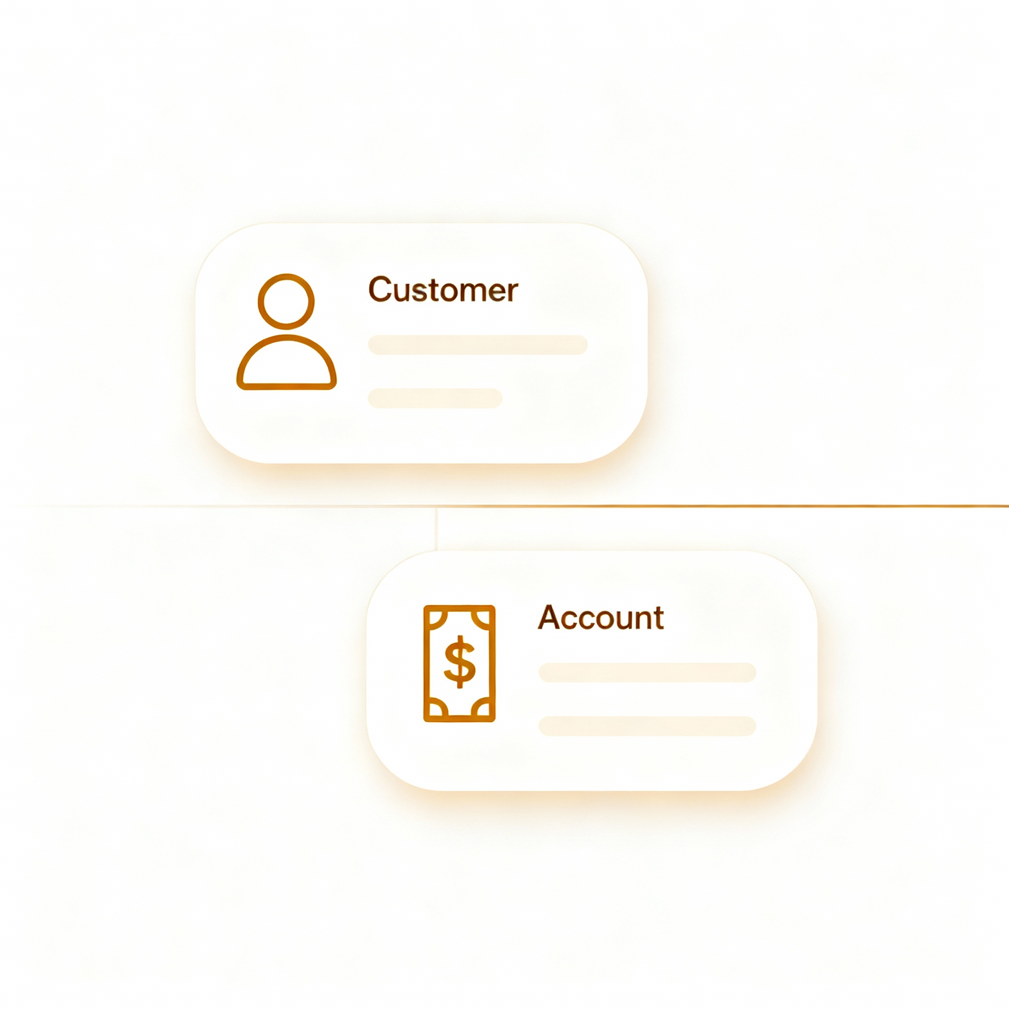
Key design considerations
Design with purpose, keep classes focused, and protect your data
Single Responsibility
Keep Customer and Account distinct
The Customer class should only manage customer information (name, contact details)
The Account class should only manage financial state (balance, status)
Avoid mixing responsibilities

Slide 19

Key design considerations
Design with purpose, keep classes focused, and protect your data
Encapsulation is key
Hide internal data by making fields private
All changes to state, like updating a balance or changing an email, should happen through public methods (deposit(), updateEmail())
Add validation and business rules to protect the integrity of your objects
Don’t expose what is not necessary

Slide 20
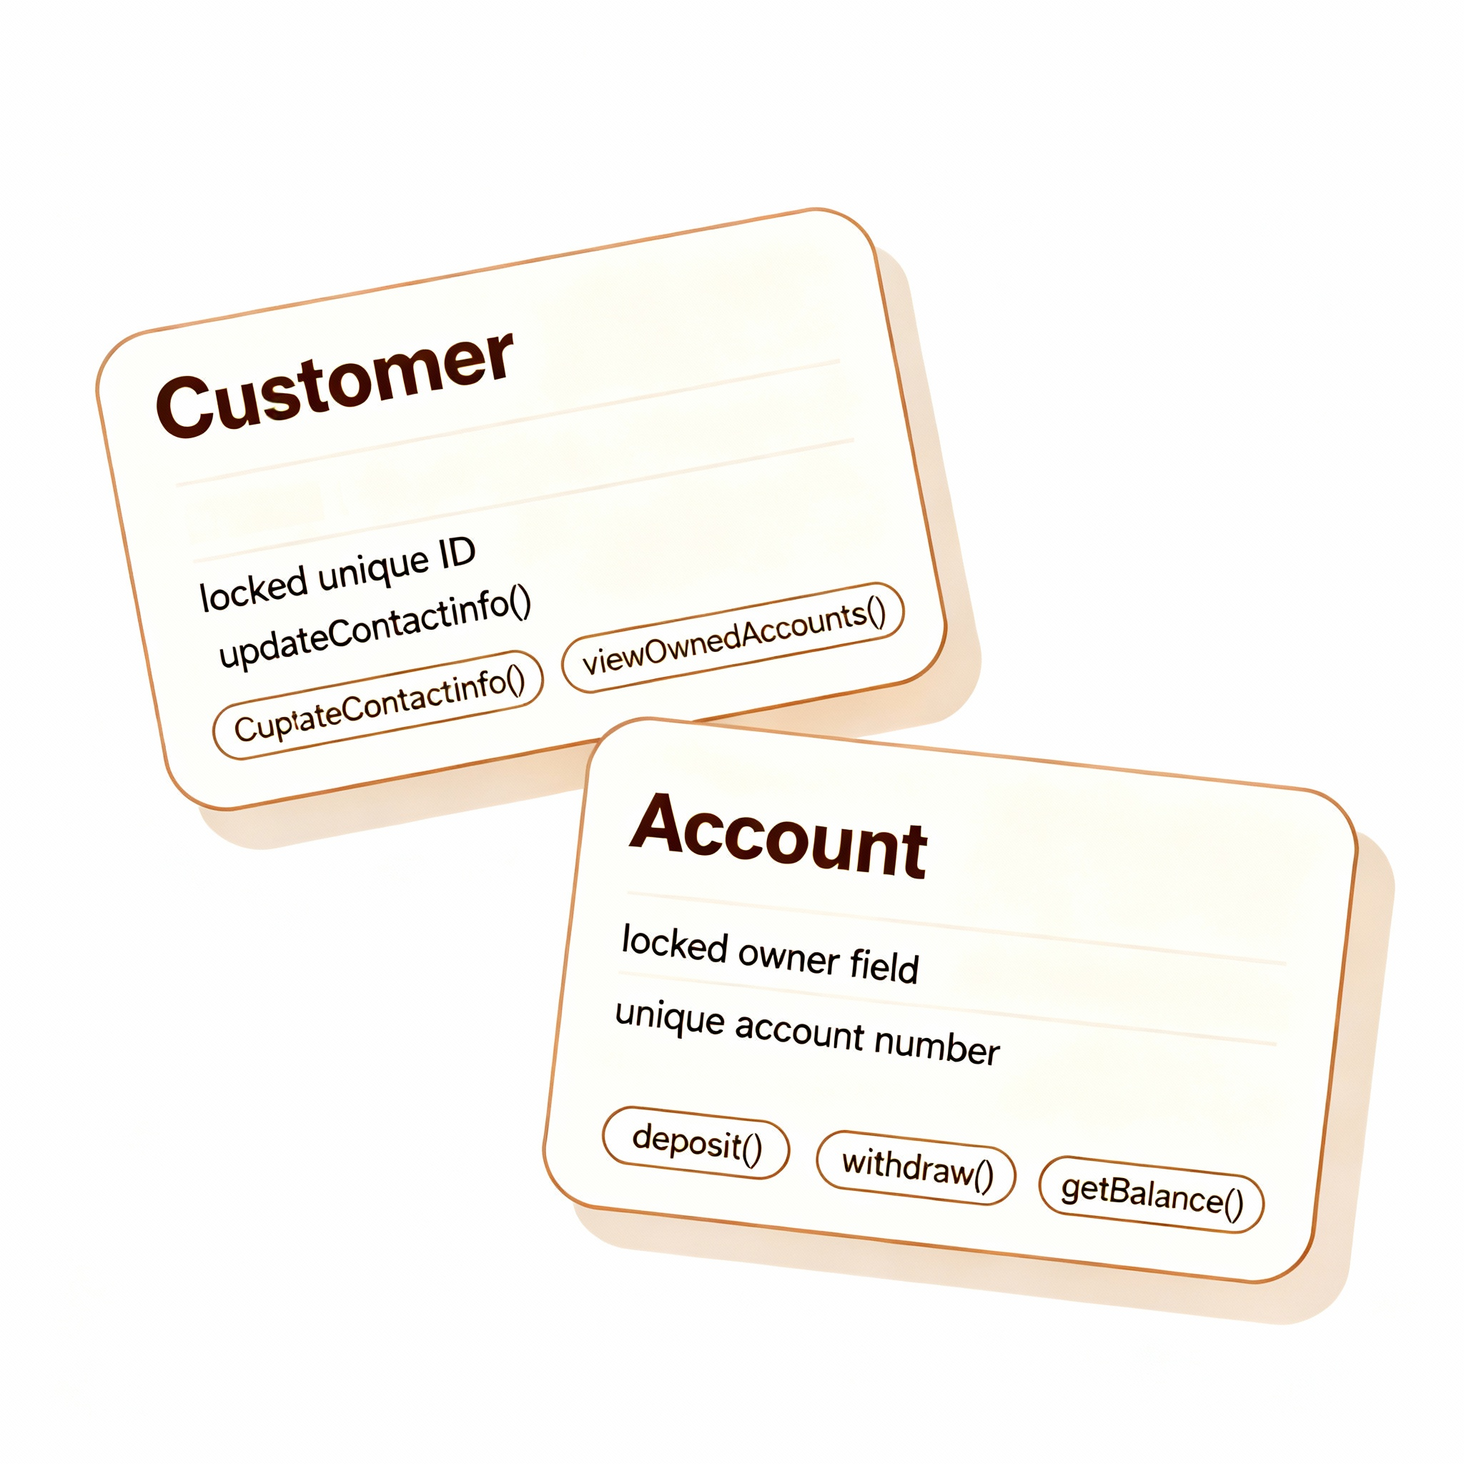
Key design considerations
Design with purpose, keep classes focused, and protect your data
Design for clarity and independence
A Customer should have a unique, unchangeable ID. Its methods should reflect its role: updateContactInfo(), viewOwnedAccounts()
An Account must always have an owner and a unique account number. Its methods should manage its financial state: deposit(), withdraw(), getBalance()
Connect independent objects

Slide 21

UML to Design

Slide 22

Quick intro to uml (class diagrams)
UML: a standardized visual language to model systems before and during development
Defines a common way to visualize, specify, construct, and document software and business systems (we’ll discuss it briefly)
Offers multiple diagram types to capture structure (what exists) and behavior (what happens) across the lifecycle

Slide 23
Quick intro to uml (class diagrams)
Class diagram: graphical notation used to construct and visualize object-oriented systems
Describes the structure of a system by showing
classes,
their attributes,
operations (or methods),
and the relationships among objects
A Class is a blueprint for an object
An object is an instance of a class

Slide 24
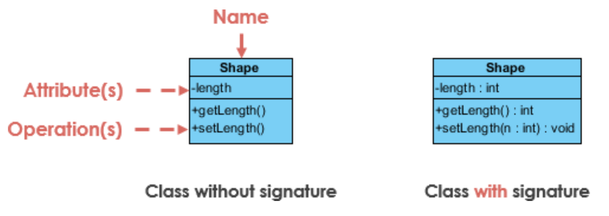
UML class notation
A class represent a concept which encapsulates state (attributes) and behavior (operations)
Each attribute has a type
Each operation has a signature
The class name is the only mandatory information
The name of the class appears in the first partition
Attributes are shown in the second partition
Operations are shown in the third partition

Slide 25
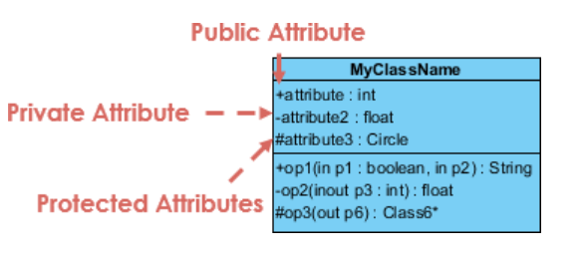
UML class notation
Attributes and methods can have various visibilities
The +, - and # symbols before an attribute and operation name in a class denote the visibility of the attribute and operation
+ denotes public attributes or operations
- denotes private attributes or operations
# denotes protected attributes or operations

Slide 26
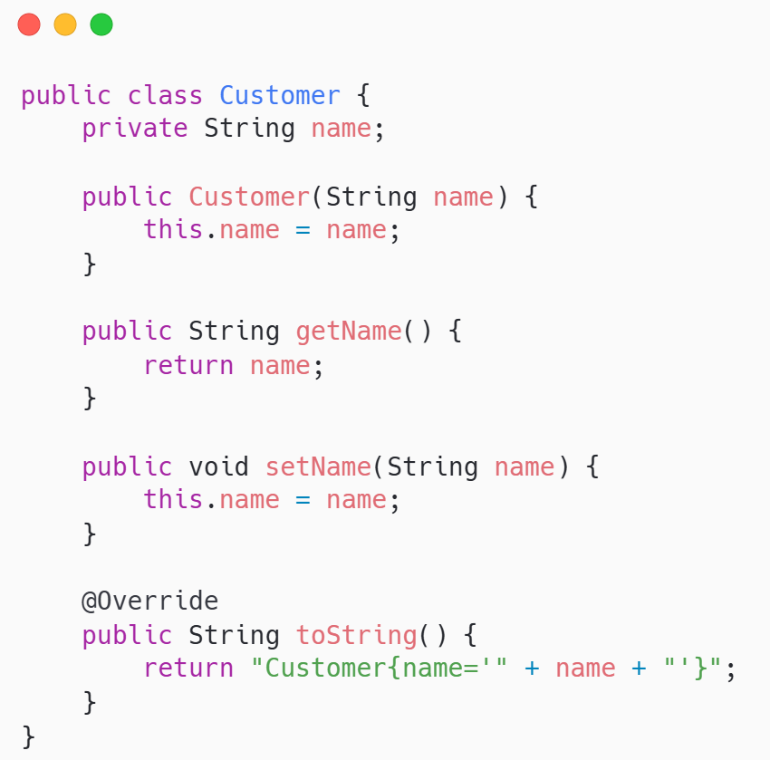
Show me the code
Customer: represents the owner of bank accounts
basic implementation; will expand

Slide 27
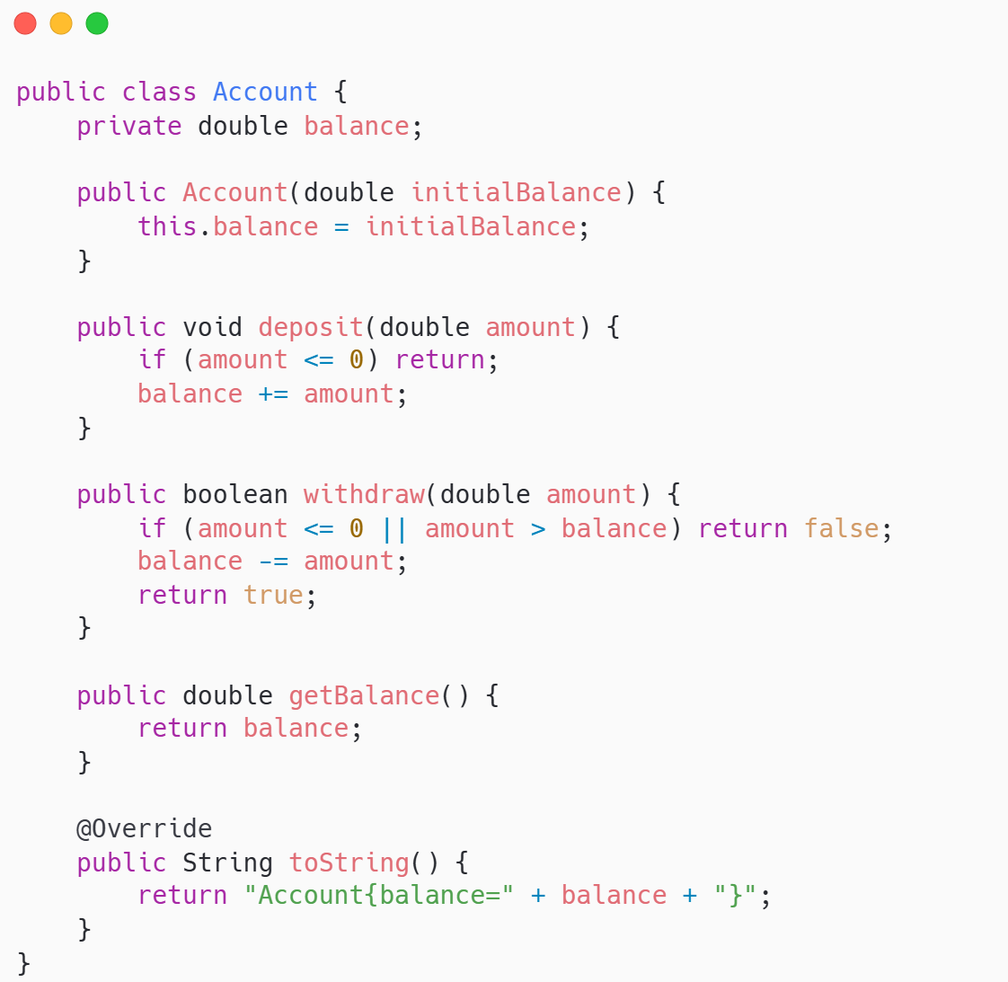
Show me the code
Account: manages money safely via controlled operations
basic implementation; will expand

Slide 28


If you were to remember only one thing …
Classes define structure; objects are live instances with state and behavior
A class is a blueprint that specifies attributes and methods
An object is a concrete instance created from that blueprint
Clear class design (single responsibility, meaningful names) makes systems easier to understand, extend, and test

Slide 29


Quote of the week
Keep what matters Leave what doesn’t

